Slide 1
React basics

Slide 2
agenda
ReactJS overview
Create React App
Components and props
Conditional rendering
Hooks overview & useId hook
State & useState hook
Component lifecycle & useEffect hook
Custom hooks

Slide 3
ReactJS Overview

Slide 4
Features
Declarative
Design simple views for each state in your app
Render just the right components on data changes
Component-Based
Encapsulated and manage their own state
Keep state out of the DOM
Isomorphic
JavaScript that runs both on client & server
Native support with React Native

Slide 5
Create react app

Slide 6
Transpile and bundle in react
Write code
Transpile code – by compiler (Babel)
Bundle code – by module bundler (Webpack)
Optimize code – by module bundler (Webpack)
Run the application
Deployment
Notes:
Защо би ни потрябвал такъв тул
Пишем код, използвайки модерен JS
Кодът се транспилира до Vanilla JS, така че кодът да е compatible и за по-стари браузъри и среди; това става чрез компилатор, в случая Babel
Кодът може да бъде bundle-нат – разбива кода на малки, оптимизирани пакети; чрез module bundler, в случая Webpack
Кодът може да се оптимизира чрез допълнителни webpack конфигурации, напр. Tree shaking – разпознаване на неизползван код и го изключва от финалния бъндъл
Кодът може да бъде ръннат и деплойнат

Slide 7
Create React app
Provides out-of-the-box build script and development server
Less to Learn
No need to configure build tools
Instant reloads and optimized bundles
No Lock-In
Webpack, Babel, ESLint
npx create-react-app app-name
For TS configs, add – –template typescript
Notes:
Create React App е command line tool, който
сетъпва основния скелет на приложението
сетъпва ни дев сървър и билд процес
Спестява конфигурации на Babel, Webpack, web server и директно можем да пишем код

Slide 8
Demo
Create React App
Notes:
Създай проект

Slide 9
react components

Slide 10
React components
Building blocks of React
Individual pieces that display parts of the page
Could be functions or classes (legacy) which return JSX
Could be stateful or stateless
Uses props to communicate between parents and children
Re-renders on each prop change or state change

Slide 11
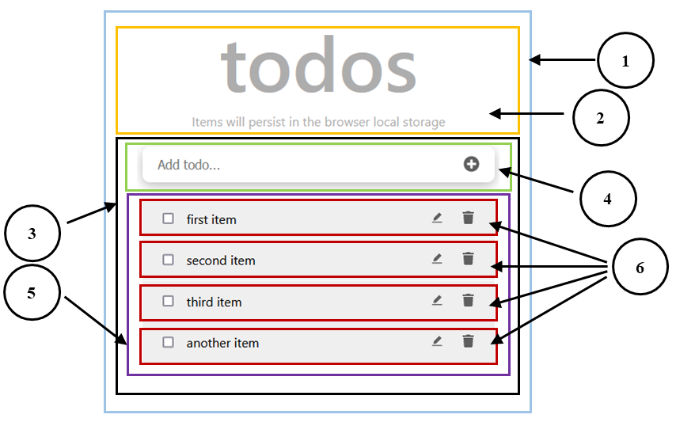
React components

Slide 12

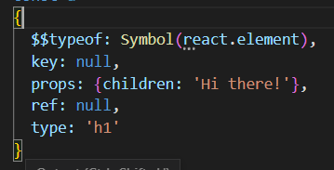
JSX
What we write
Babel
What
runs in the browser
What is returned from ‘createElement’

Slide 13
JSX Syntax
Pass in text, numbers, arrays etc
<MyComponent name='Text'/>
<MyComponent age={3 + 3} />
Expressions
const person = {
name: 'Mimi',
age: 18,
job: 'Software Consultant‘
}
<MyComponent data={person} />
Pass whole objects as props

Slide 14
JSX Rules and principles
Standard HTML elements use lowercase names – div, h1, form,…
Custom components always use Pascal case – MyComponent, Header,…
There must be a root element
Use either React.Fragment or (<></>) to not break container
In the { } of JSX you can use:
Any kind of operators – &&, ||, !, ===, !==, …
String Concatenation – <div>{"Hello " + name}</div>
Variables – <h1>Hello, {name}</h1>
Array mapping – <ol>{users.map((u) => <li>{u.name}</li>)}</ol>

Slide 15
props

Slide 16
props
The way to communicate between components
They can be of any type (strings, numbers, arrays, objects etc…)
They can be typed:
Using prop-types
Using TypeScript
<Welcome name=“Sara” />
const Welcome = (props) => {
return <h1>Hello, {props.name}</h1>
}

Slide 17
Key prop
Required when rendering lists
Sibling components should have unique keys
Give an identify to elements / components
If the key changes, the component re-renders
function AppointmentsList({ appointments }) {
return (
<ol>
{appointments.map((i) => (
<AppointmentItem key={i.id} item={i} />
)}
</ol>
);
}

Slide 18
Children prop
Used to display whatever you include between <> and </> when invoking a component.
const Section = () => (
<Article title=“React”>
React is awesome, isn’t it?
</Article>
)
const Article = ({ title, children }) => (
<>
<h1>{title}</h1>
{children}
</>
)

Slide 19
Demo
Rendering lists
Children prop
Notes:
Добави initial todos
Импортни ги и ги рендерирай

Slide 20
Conditional rendering

Slide 21
Conditional Rendering
With ordinary if, if-else or if-else if-else
Inline with &&
With ternary operator
function Greeting({ isLoggedIn }) {
return (
<div>
{isLoggedIn ? (
<h1>Welcome back!</h1>
) : (
<h1>Please sign up.</h1>
)}
</div>
);
}
function Greeting({ isLoggedIn }) {
return (
<div>
{isLoggedIn && <h1>Welcome back!</h1>}
</div>
);
}

Slide 22
Preventing component render
In rare cases you might want a component to hide itself even though it was rendered by another component
To do this return null instead of its render output:
function Loading({ loading }) {
if (!loading) {
return null;
}
return <div>Loading…</div>;
}

Slide 23
Hooks overview

Slide 24
REACT hooks
Give special abilities to functional components
New addition in React 16.8
Can be stateful and manage side-effects
Place them at the top level of your component.
Always name them with the ”use” prefix
Rules:
Don’t call hooks conditionally
Don’t call hooks in nested functions (e.g., in useEffect)

Slide 25
Use id hook
const Form = () => {
const id = useId();
return (
<form>
<label htmlFor={`${id}-name`}>Name</label>
<input id={`${id}-name`} />
<label htmlFor={`${id}-age`}>Age</label>
<input id={`${id}-name`}/>
</form>
)}
Generates unique ids
Designed to combine HTML elements (useful for forms)
Don’t use as:
a key prop
a CSS selector

Slide 26
Demo
useId hook

Slide 27
State & use state hook

Slide 28
State
Determines how the component renders and behaves
Allows to create components that are dynamic and interactive
Has a default value when a component mounts
After mounts, suffers from mutations in time
It's serializable
Components can either manage their own state or receive it from a parent component

Slide 29
Stateful vs stateless components
Stateful components:
Also called Controllers/Pages
Hold all the state
Pass state down to child components
Stateless components:
Also called Presentation/UI Components
They just render JSX

Slide 30
Use state hook
useState is a hook that lets you add react state to functional components
import { useState } from ‘react’;
const [state, setState] = useState(false);
State variable
Initial value
Function, that modifies the state

Slide 31
Use State hook
The only argument it receives is its initial state, used only during first render
Re-renders the component when the state is modified
You can use it more than a single time inside a component
To update the state, always use the update function
Updates can happen based on previous state
const [count, setCount] = useState(0);
const increment = () => {
setCount((prev) => prev + 1)
}
If using TS: useState<number>(0)

Slide 32
Demo
useState hook
Notes:
Използвай useState за рендерирането на todo-тата
Имплементирай toggle todo
Имплементирай добавяне на todo

Slide 33
lifecycle & use effect hook

Slide 34
Lifecycle in React components
Mount
Initial render of the component
The component is inserted to the DOM
Update
Re-render of the component
When props or local state are updated
Unmount
The component is removed from the DOM

Slide 35
Use effect hook
Setup function, optionally can return a cleanup function
Allows to perform side-effects (fetch data, attach event listeners, …)
Setup function
Fired on mount phase
Can return a cleanup function, fired on unmount phase
Dependency array
If one changes, the setup function is fired again
useEffect(() => {
// setup logic
return () => {
// cleanup (optional)
}
}, [])
Array of dependencies

Slide 36
Cleanup function
Some effects require cleanup function to reduce memory leaks
useEffect(() => {
const handleResize = () => {
console.log(“Window resized”);
}
window.addEventListener(“resize”, handleResize);
return () => {
window.removeEventListener(“resize”, handleResize)
}
}, [])

Slide 37
Demo
useEffect hook
Notes:
Имплементирай съхраняване в localStorage
useEffect за проверка на localStorage, ако има нещо => update на todos, ако не => сетване на default-ните todo-та
При toggle и add => добавяне на localStorage логиката

Slide 38
custom hooks

Slide 39
Custom hooks
JS functions, that use build-in hooks
Name always start with use
Allow to reuse stateful logic
const useFetch = (url) => {
const [data, setData] = useState(null);
useEffect(() => {
fetch(url)
.then((res) => res.json())
.then((data) => setData(data));
}, [url]);
return data;
};

Slide 40
Demo
Custom hook

Slide 41

Questions?

